Slide 1
Kalman Filtering

Slide 2

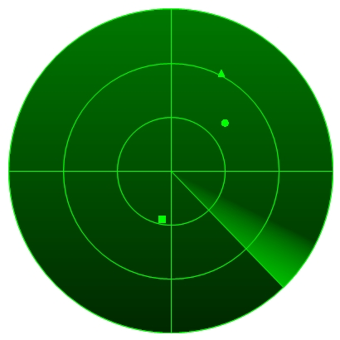
Kalman Filtering
(Optimal) estimation of the (hidden) state of a
linear dynamic process of which we obtain noisy (partial) measurements
Example: radar tracking of an airplane.
What is the state of an airplane given noisy radar measurements of the airplane’s position?

Slide 3
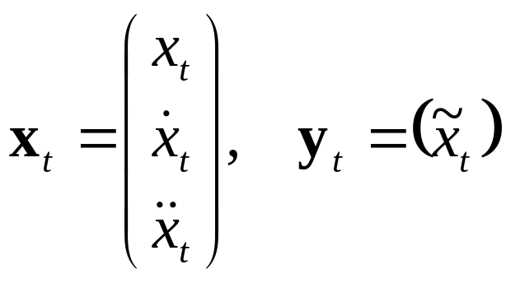
Model
Discrete time steps, continuous state-space
(Hidden) state: x_{t} , measurement: y_{t}
Airplane example:
Position, speed and acceleration

Slide 4
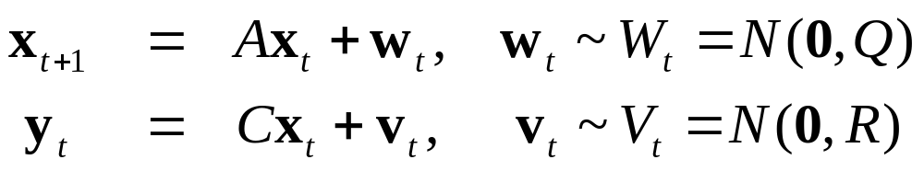
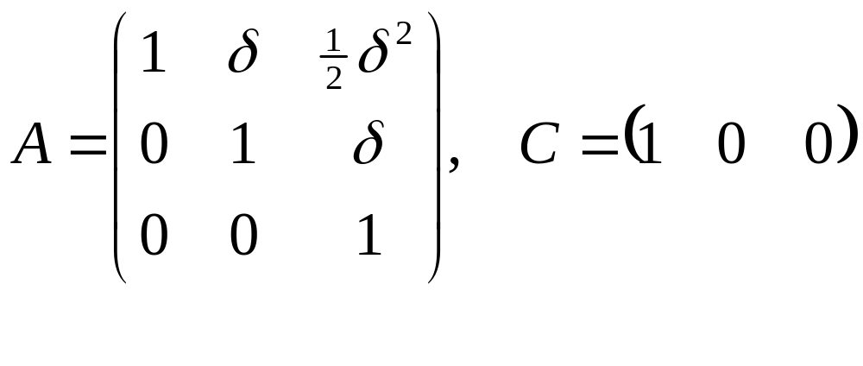
Dynamics and Observation model
Linear dynamics model describes relation between the state and the next state, and the observation:
Airplane example (if process has time-step δ):

Slide 5
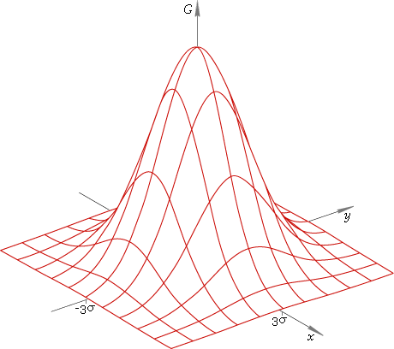
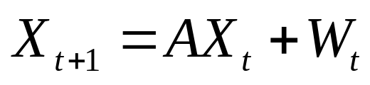
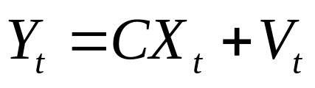
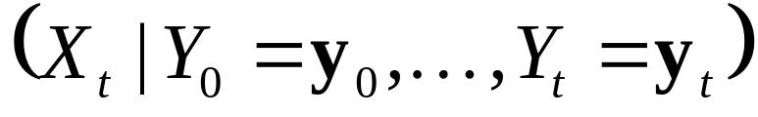
Normal distributions
Let X₀ be a normal distribution
of the initial state x₀
Then, every X_{t} is a normal distribution of hidden state x_{t}. Recursive definition:
And every Y_{t} is a normal distribution of observation y_{t}. Definition:
Goal of filtering: compute conditional distribution

Slide 6
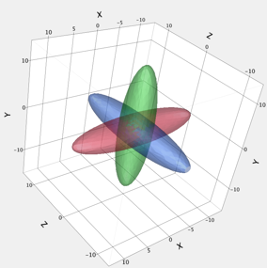

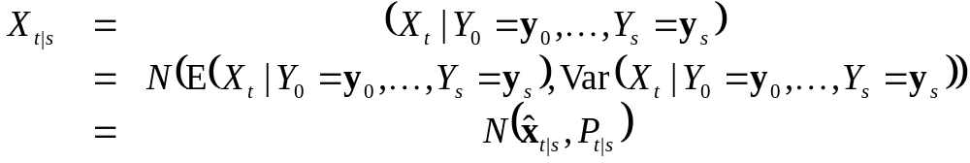
Normal distribution
Because X_{t}’s and Y_{t}’s are normal
distributions,
is also a normal distribution
Normal distribution is fully
specified by mean and covariance
We denote:
Problem reduces to computing x_{t|t} and P_{t|t}

Slide 7
Recursive update of state
Kalman filtering algorithm: repeat…
  Time update:
  from X_{t|t}, compute a priori distrubution X_{t+1|t}
  Measurement update:
  from X_{t+1|t} (and given y_{t+1}), compute a posteriori distribution X_{t+1|t+1}
X₀
X₁
X₂
X₃
X₄
X₅
…
Y₁
Y₂
Y₃
Y₄
Y₅

Slide 8
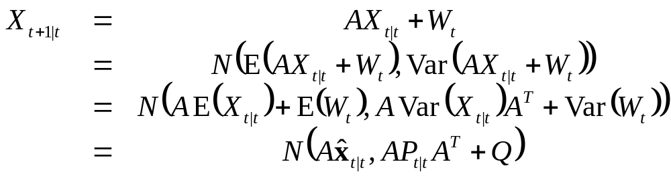
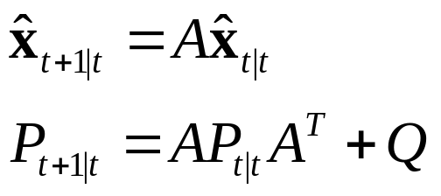
Time update
From X_{t|t}, compute a priori distribution X_{t+1|t}:
So,

Slide 9
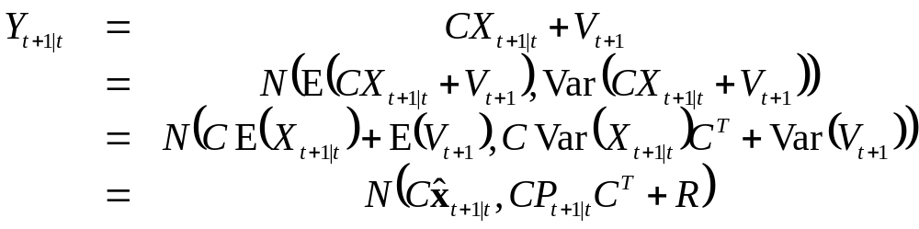
Measurement update
From X_{t+1|t} (and given y_{t+1}), compute X_{t+1|t+1}.
1. Compute a priori distribution of the observation Y_{t+1|t} from X_{t+1|t}:

Slide 10
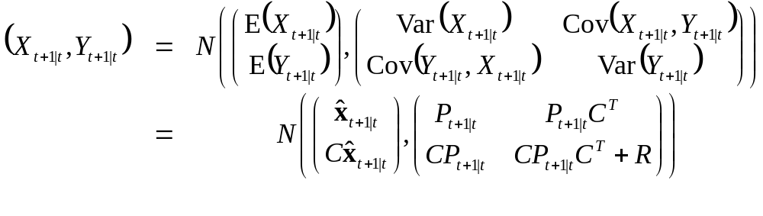
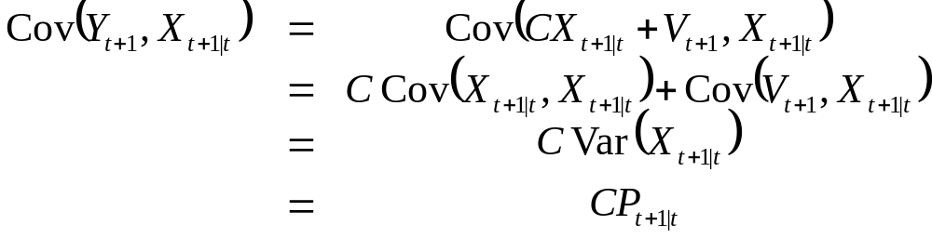
Measurement update (cont’d)
2. Look at joint distribution of X_{t+1|t} and Y_{t+1|t}:
where

Slide 11
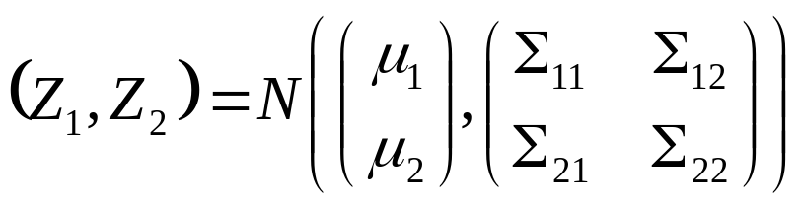
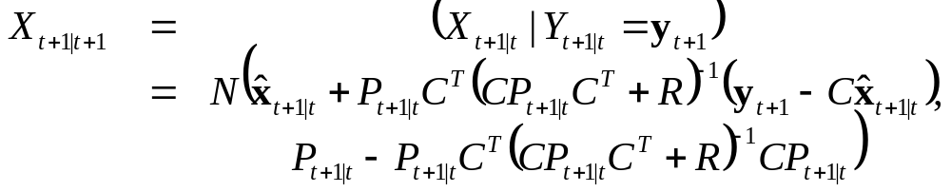
Measurement update (cont’d)
Recall from undergrad that if
then
3. Compute X_{t+1|t +1} = (X_{t+1|t}|Y_{t+1|t} = y_{t+1}):

Slide 12
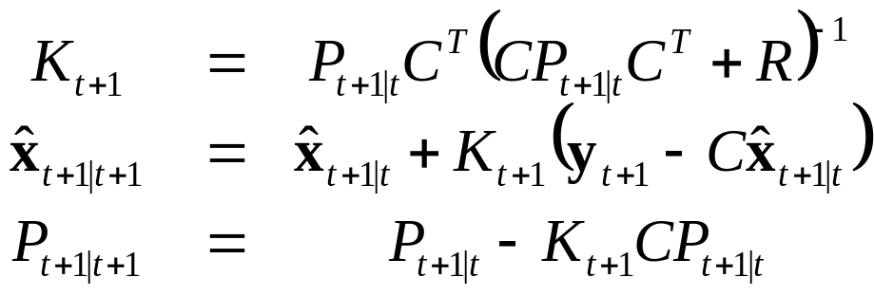
Measurement update (cont’d):
Often written in terms of Kalman gain matrix:

Slide 13
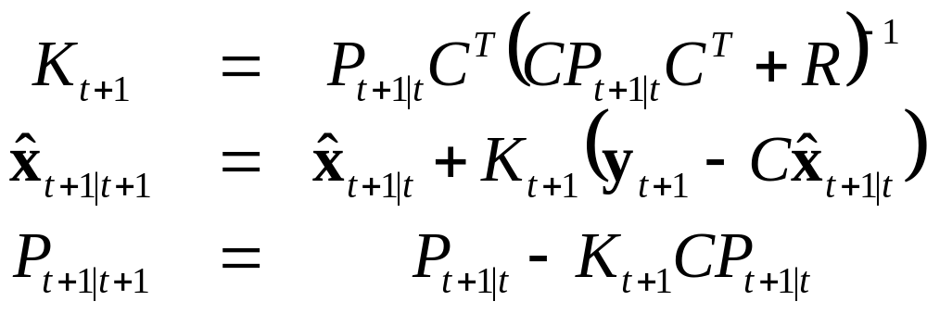
Kalman filter summary
Model:
Algorithm: repeat…
  Time update:
  Measurement update:

Slide 14
Initialization
Choose distribution of initial state by picking x₀ and P₀
Start with measurement update given measurement y₀
Choice for Q and R (identity)
  small Q: dynamics “trusted” more
  small R: measurements “trusted” more

Slide 15
Conclusion
Kalman filter can be used in real time
Use x_{t|t}’s as optimal estimate of state at time t, and use P_{t|t} as a measure of uncertainty.

Slide 16
Extensions
Dynamic process with known control input
Non-linear dynamic process
Kalman smoothing: compute optimal estimate of state x_{t} given all data y₁, …, y_{T},
with T > t (not real-time).
Automatic parameter (Q and R) fitting using EM-algorithm

